Slide 1

Software Development Life Cycle (SDLC)

Slide 2

A framework that describes the activities performed at each stage of a software development project.

Slide 3

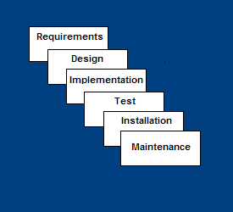
Requirements – defines needed information, function, behavior, performance and interfaces.
Design – data structures, software architecture, interface representations, algorithmic details.
Implementation – source code, database, user documentation, testing.

Slide 4

Easy to understand, easy to use
Provides structure to inexperienced staff
Milestones are well understood
Sets requirements stability
Good for management control (plan, staff, track)
Works well when quality is more important than cost or schedule

Slide 5

All requirements must be known upfront
Deliverables created for each phase are considered frozen – inhibits flexibility
Can give a false impression of progress
Does not reflect problem-solving nature of software development – iterations of phases
Integration is one big bang at the end
Little opportunity for customer to preview the system (until it may be too late)

Slide 6

Requirements are very well known
Product definition is stable
Technology is understood
New version of an existing product
Porting an existing product to a new platform.

Slide 7

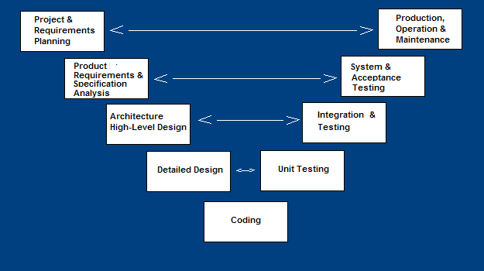
A variant of the Waterfall that emphasizes the verification and validation of the product.
Testing of the product is planned in parallel with a corresponding phase of development

Slide 8

Emphasize planning for verification and validation of the product in early stages of product development
Each deliverable must be testable
Project management can track progress by milestones
Easy to use

Slide 9

Does not easily handle concurrent events
Does not handle iterations or phases
Does not easily handle dynamic changes in requirements
Does not contain risk analysis activities

Slide 10

Excellent choice for systems requiring high reliability – hospital patient control applications
All requirements are known up-front
When it can be modified to handle changing requirements beyond analysis phase
Solution and technology are known

Slide 11
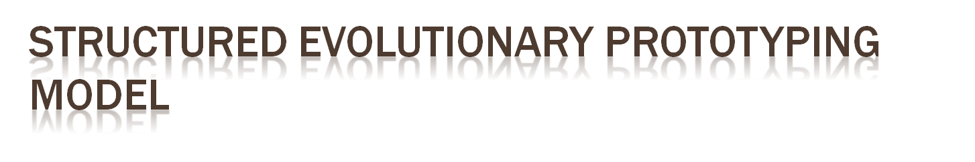
Developers build a prototype during the requirements phase
Prototype is evaluated by end users
Users give corrective feedback
Developers further refine the prototype
When the user is satisfied, the prototype code is brought up to the standards needed for a final product.

Slide 12
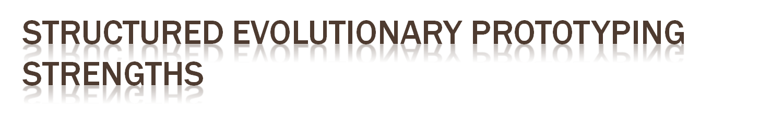
Customers can “see” the system requirements as they are being gathered
Developers learn from customers
A more accurate end product
Unexpected requirements accommodated
Allows for flexible design and development
Steady, visible signs of progress produced
Interaction with the prototype stimulates awareness of additional needed functionality

Slide 13
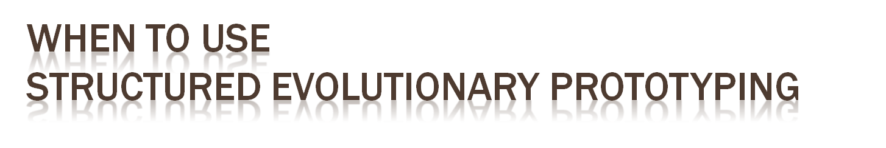
Requirements are unstable or have to be clarified
As the requirements clarification stage of a waterfall model
Develop user interfaces
Short-lived demonstrations
New, original development
With the analysis and design portions of object-oriented development.

Slide 14

Requirements planning phase (a workshop utilizing structured discussion of business problems)
User description phase – automated tools capture information from users
Construction phase – productivity tools, such as code generators, screen generators, etc. inside a time-box. (“Do until done”)
Cutover phase -- installation of the system, user acceptance testing and user training

Slide 15

Reduced cycle time and improved productivity with fewer people means lower costs
Time-box approach mitigates cost and schedule risk
Customer involved throughout the complete cycle minimizes risk of not achieving customer satisfaction and business needs
Focus moves from documentation to code.

Slide 16

Accelerated development process must give quick responses to the user
Risk of never achieving closure
Requires a system that can be modularized
Developers and customers must be committed to rapid-fire activities in an abbreviated time frame.

Slide 17

User involved throughout the life cycle
Project can be time-boxed
Functionality delivered in increments
High performance not required
Low technical risks

Slide 18

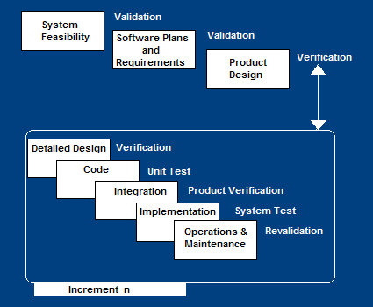
Construct a partial implementation of a total system
Then slowly add increased functionality
The incremental model prioritizes requirements of the system and then implements them in groups.
Each subsequent release of the system adds function to the previous release, until all designed functionality has been implemented.

Slide 19

Develop high-risk or major functions first
Each release delivers an operational product
Customer can respond to each build
Uses “divide and conquer” breakdown of tasks
Lowers initial delivery cost
Initial product delivery is faster
Customers get important functionality early
Risk of changing requirements is reduced

Slide 20

Requires good planning and design
Well-defined module interfaces are required
Total cost of the complete system is not lower

Slide 21

A need to get basic functionality to the market early

